Slide 1
CAR Champion Calibration Meeting CAR Review 2016-Q4 CAR Review Activity
Team “B”
Ken Berger (CAR 163916461 Observation)
Bruce Eng (CAR 163916135 Finding)
Nancy Gruspe (CAR 163916470 Finding)
Ken Berger (Exemplary CAR 163915732 Finding)

Slide 2
CAR 163915732 (Exemplary )
2016-Q4 CAR Review Activity
Ken Berger

Slide 3
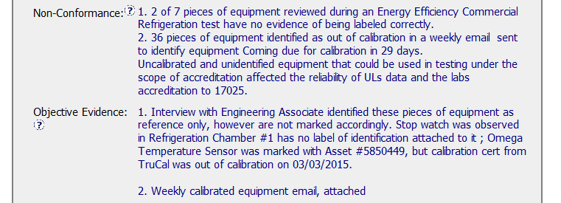
Exemplary CAR: 163915732
Problem statement

Slide 4
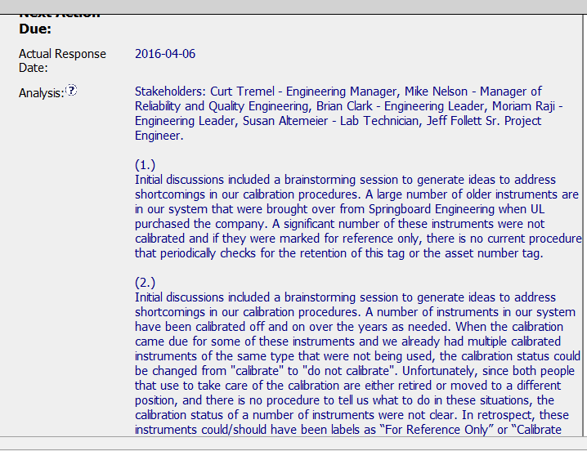
Exemplary CAR: 163915732
RCA included stakeholders☺
RCA method explained☺

Slide 5
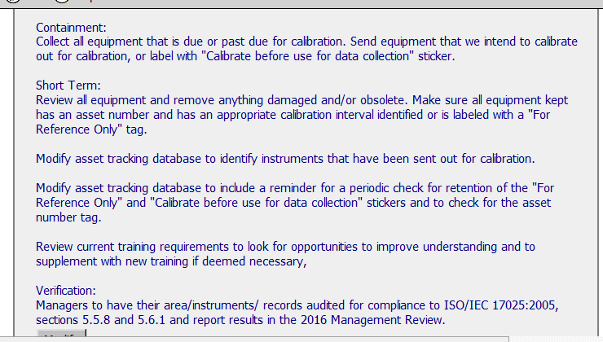
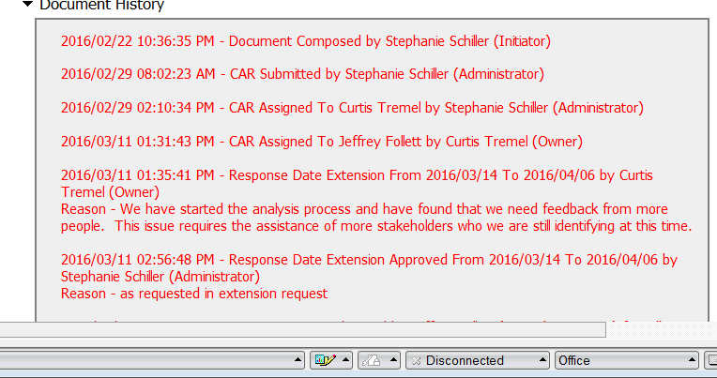
Containment, Action Plan and Verification are all identified. ☺
Extension justified & valid reason☺
Exemplary CAR: 163915732

Slide 6
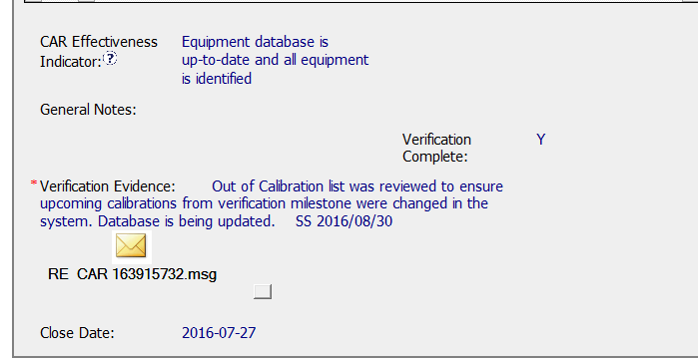
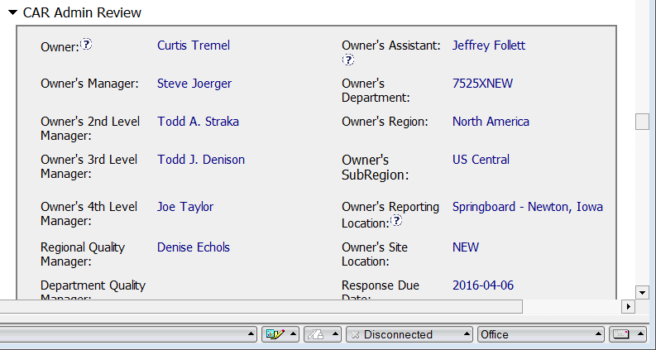
CAR was verified as effective within 5 days (maybe too soon).
Exemplary CAR: 163915732
Removed executive from escalation path☺

Slide 7
Exemplary CAR: 163915732
CBS Requirements | Excellent | Moderate | Need Improve | N/A
(C) Extensions are within requirement (<30 days, 3 or less) | √
(T) Most appropriate ‘category’, ‘type’, ‘geography’ are selected | √
(P) Facilitates the handling of disputed CARs |  |  |  | √
(T) Acts on CARs within required timeframe |  | √
(C) Analysis shows clear path to root cause and scope; stakeholders identified | √
(C) Root cause statement is succinct, reasonable, complete | √
(C) Corrective actions fix the objective evidence and other problems found; address entire root cause and scope. For observations, they do not go beyond fixing the objective evidence | √
(C) Milestones address containment & owner’s verification; completed per milestone expectations | √
(P) Verification per requirements | √
(L) Referenced communications are attached as needed | √
(C L) Evidence of communication for overdue/escalated CARs and other pertinent concerns |  |  |  | √
(P) Trains other CAR Champions |  |  |  | √

